Slide 1
Digital Portfolio
UDENT NAME: Reshma v
REGISTER NO AND NMID: 31D1A6CEE7EBA74BD184D729C9D1FA45
DEPARTMENT: BCA
COLLEGE: COLLEGE/ UNIVERSITY Prince Shri Venkateswara Arts And Science College /Madras University

Slide 2
PROJECT TITLE
Digital portfolio

Slide 3


AGENDA
Problem Statement
Project Overview
End Users
Tools and Technologies
Portfolio design and Layout
Features and Functionality
Results and Screenshots
Conclusion
Github Link
3/21/2024 Annual Review

Slide 4

PROJECT OVERVIEW
This portfolio is a responsive and user-friendly web application built with modern frontend technologies. It presents the developer’s profile, skills, and project highlights in a clean and professional design. The goal is to make the site both visually appealing and informative, ensuring that potential employers and clients can quickly understand the developer’s capabilities

Slide 5

WHO ARE THE END USERS?
The primary end users of this portfolio website include: Recruiters/Employers – To evaluate skills and projects for internship or job opportunities. Clients – To explore developer’s work and potentially collaborate on freelance projects. Peers/Community – To share ideas, inspire, and network with other developers. Personal Branding – To serve as an online resume and showcase continuous learning.

Slide 6

TOOLS AND TECHNIQUES
Tools
HTML code
CSS
JS
Web browser

Slide 7
POTFOLIO DESIGN AND LAYOUT
Header Section: Displays the developer’s name, role (Frontend Web Developer), academic details, and quick call-to-action buttons (Visit My Work, GitHub). Navigation Bar: Provides smooth navigation to key sections (About Me, Projects, Skills, Contact). About Me Section: Introduces the developer, academic background, passion, and interests. Projects Section: Highlights completed projects such as Portfolio Website, Todo App, and Blog Platform, each with a short description and “View Project” button. Skills Section (not visible in screenshot but likely present): Showcases technical skills such as HTML, CSS, JavaScript, and frameworks. Contact Section: Provides ways to get in touch (email, social media, GitHub). The layout uses a clean card-based design, consistent color scheme (black, white, and red), and responsive grid for projects.
7

Slide 8
FEATURES AND FUNCTIONALITY
Responsive Design – Works seamlessly on desktop, tablet, and mobile devices. Project Showcase – Interactive cards with descriptions and project links. Navigation Bar – Easy switching between sections without clutter. Call-to-Action Buttons – Direct access to GitHub and project demos. Clean Typography & Colors – Enhances readability and maintains a professional look. Scalability – Easy to add new projects, skills, or achievements

Slide 9
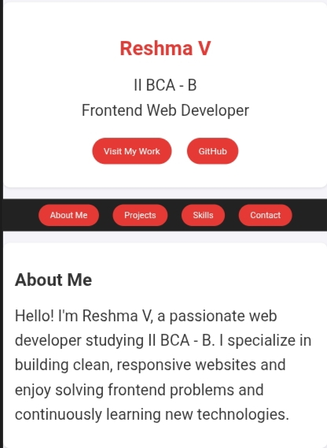

RESULTS AND SCREENSHOTS
A responsive portfolio website
2. Sections like About Me, Projects, Skills, Contact
3. Buttons linking to your work samples and GitHub.
4. A clean, professional design that works on mobile and desktop.
3/21/2024 Annual Review
9

Slide 10
CONCLUSION
The portfolio website successfully achieves its purpose of creating a professional online identity for the developer. It combines simplicity, responsiveness, and functionality to present skills and projects in a way that is appealing to employers, clients, and peers. As a continuously evolving project, it allows for updates and improvements as new skills and projects are acquired, making it a long-term personal branding tool.
10

Slide 11
Problem statement
The aim of this project is to design and develop a personal portfolio website that highlights the skills, projects, and achievements of a frontend web developer. The portfolio serves as a digital identity to showcase technical expertise, provide easy access to projects, and create a professional presence online.

Slide 12
GitHub link
https://vijayreshma62.github.io/TNSDC-FWD-DP/

